Slide 1
Introduction to Computer Organization

Slide 2
Course Book
‘Computer Organization and Architecture’ by William Stallings (9th Edition or up)
Reference Books:
‘The Intel Microprocessors’ by Barry B. Brey (8th edition)

Slide 3
Course Outline (CA&Org)
Chapter-1: Basic Concepts and Computer Evolution.
Chapter-2: Computer Evolution and Performance.
Chapter-3: A top-level View of Computer Function and Interconnection.
Pipelining + Parallelism
After Mids:
Chapter-4: Cache Memory.
Chapter-5: Internal Memory.
Chapter-6: External Memory.
Chapter-7: Input-Output.

Slide 4
Marks Distribution
Assignments & Lab Reports: The assignments will be submitted as desired by the instructor. The labs will be conducted as required for the course.
Pre- Requisite: None
Grading Policy:
Internal assessment: 25%
Mid Term Exam : 25%
End Semester Exam : 50%
Labs Work : 25% (absolute marks)
Note: Labs will be conducted on Lab Days as per time table.

Slide 5
How to Study This Course
The point is learning, and learning requires effort, no shortcut here.
Never ever limit yourself to a single source of information, use multiple sources.
Approach each of your sources with specific questions in mind, with the goal of finding answers to those questions.
Apply that information, don’t let it remain idle in your brain, this is how you construct your own understanding.
The final step is to establish a ‘Feedback loop’, enabling the learner to self-correct errors in understanding.
Practice, practice and practice until you get it done, coz nothing is impossible in this world.

Slide 6
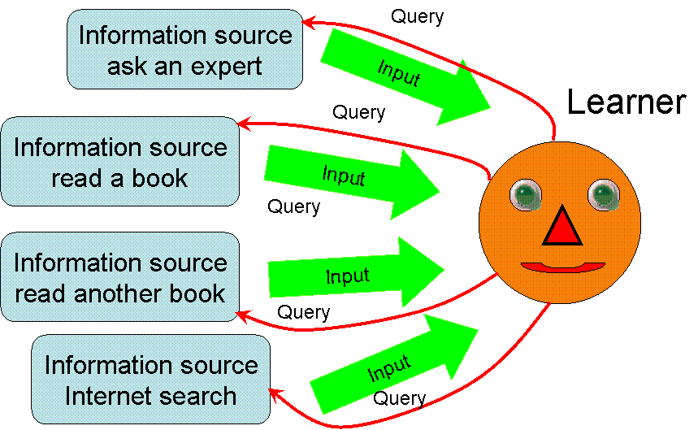
Approach to Learning
Application
Write in your own words
output
Application
Describe what U learn
output
output
Application
Teach your friends
output
Application
Build something
output
Application
Practice, practice, practice

Slide 7
Rules of Class
Always get in the class in time. 5 minutes till start time.
Concentrate on what is being taught in class.
Don’t involve in talking or using mobiles.
Ask questions by first raising your hand and then delivering words.
Do not pass comments in the class.
Always make notes for your own benefit.
Teachers decision will be final in every aspect. No late Assig/Quiz etc.

Slide 8
Difference b/w Organization & Architecture
Computer Organization | Computer Architecture
Organization is the implementation of the Architecture. It deals with low level design issues. (Micro-Architecture) | Architecture is the underlying hardware. It deals with high level design issues.
Transparent from programmer (ex. A programmer does not worry much how addition is implemented in hardware) | Programmer view (i.e. Programmer has to be aware of which instruction set used) It can be seen as an agreement between a Hardware designer and a computer programmer. (Interface)
Physical components (Circuit design, Adders, Signals, Peripherals) | Logic (Instruction set, Addressing modes, Data types, Registers)
How to do? | What to do? (Instruction set)

Slide 9
Architecture and Organization
Computer Architecture | Computer Organization
Architecture is the underlying hardware. | Computer Organization is realization of Architecture.
Architecture describes what a computer does. | Organization describes how it does it.
For designing a computer, architecture is fixed first | Organization is decided after its architecture.
It deals with high level design issues. | It deals with low-level design issues.
It includes instruction set, supported data types, I/O mechanism used, addressing modes, registers. | It includes hardware details such as control signals, interfaces of peripherals, memory technology used.
As a programmer you should know about it first. | A programmer should not be aware of it.
No operating system can be designed without it. | Organization indicates its performance.
Architecture is abstract or higher level. | It changes with changing technology.
Example: Intel and AMD created x86 processor. | Organization may be different for both.

Slide 10
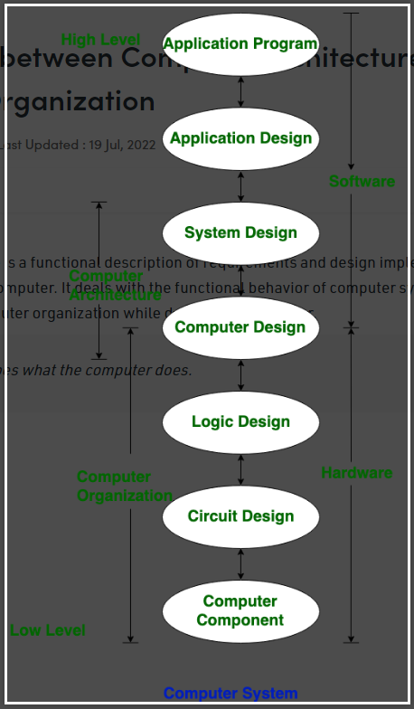

Slide 11
Difference between Organization & Architecture
Computer Architecture refers to those attributes of a system visible to a machine language programmer. (e.g. If the program may run on system)
Architectural attributes include the instruction set, the number of bits used to represent various data types (e.g., numbers, characters), I/O mechanisms, and techniques for addressing memory.
It is difficult to design an Operating System well without the knowledge of the underlying architecture.

Slide 12
Notes
Architecture is the underlying hardware.
Instruction set is the complete set of all the instructions in machine code that can be recognized and executed by a ‘Central Processing Unit’ (CPU).
Data types e.g. integer, float, double, character.
Moreover a 32-bit system uses a 32-bit microprocessor e.g. CPU registers and address buses or data buses are of that width.
Whereas a 64-bit system manipulates 64 bits at a time.
Techniques for addressing memory like direct addressing, indirect addressing, paging etc.

Slide 13
32-bit and 64-bit Architecture
In computer architecture, 32-bit system has integers, memory addresses, or other data units are those that are 32 bits (4 bytes) wide. Also, 32-bit CPU and ALU architectures are those that are based on registers, address buses, or data buses of that size. 32-bit computers support a maximum of 4 GB (2³² bytes) of memory.
A 64-bit processor is a microprocessor with a word size of 64 bits, a requirement for memory and data intensive applications such as computer-aided design (CAD) applications, database management systems, technical and scientific applications, and high-performance servers.

Slide 14
32-bit and 64-bit (Continued)
The terms 32-bit and 64-bit refer to the way a computer's processor (also called a CPU), handles information. The 64-bit version of Windows handles large amounts of random access memory (RAM) more effectively than a 32-bit system.
Does 32-bit software run on 64-bit Operating System?
Yes, a 32 bit software can be run on a 64 bit Operating System. When a 32 bit software is launched, in Windows for example, an emulator is launched. The emulator 'tricks' the 32 bit software and makes it think that it's running on a 32 bit system.

Slide 15
Difference between Organization & Architecture
Computer Organization refers to the operational units and their interconnections that realize the architectural specifications.
Organizational attributes include hardware details transparent to the programmer such as control signals, interfaces between the computer and peripherals, and the memory technology used (HDSk or SSD).
Organization changes with changing technology whereas architecture is abstract/higher level.

Slide 16
Notes
Computer organization refers to the interconnections between the operational units that form the architecture.
Control signals tell the computer’s memory, ALU unit and I/O devices how to respond to a program’s instructions. Such signals are generated by a ‘Control Unit’ (CU).
Interface means how external devices connect and communicate with the computer system. This interface is provided by a ‘port’ on a compute system.
Memory technology such as cache memory, RAM, magnetic disk etc. This is called a ‘memory hierarchy’. Data is organized in this hierarchy.

Slide 17
Notes
The technology is constantly changing, based on business demands and advancements in industry.
Organizational attributes adapts to these changes by restricting components e.g. splitting the cache into two, one for instruction and one for data. Or adding or removing components e.g. adding another level of cache to improve performance.
Architectural component models represent high level designs. Pentium-4 CPU was introduced in 2000. Intel introduced ‘core’ technology in 2006. So the change in architecture is gradual and it remains the same for quite some time.

Slide 18
Difference between Organization & Architecture
For Example-1:
It is an ‘architectural’ design issue whether a computer will have a multiply instruction.
However it is an ‘organizational’ issue whether that instruction will be executed by a special multiply unit or by add unit with repeated additions.
The ‘organizational Decision’ may be based on the anticipated frequency of use of the ‘multiply’ instruction, the relative speed of the two approaches, and the cost and physical size of a special multiply unit.

Slide 19
Example-2
It is an ‘architectural’ design issue whether a computer will have a add instruction.
How to implement an adder is part of computer ‘organization’. Meaning it could be a ‘serial adder’, or ‘carry look ahead adder’ or ‘ripple adder’.
However the choices of an adder will affect the time taken by an ADD instruction to complete its operation, and this ultimately affects systems ‘Performance’.

Slide 20
Example-3
For example, both Intel and AMD processors have the same X86 architecture.
The same programs run correctly on both, because the architecture (instruction set and hardware components) is the same.
But how the two companies implement that architecture (their computer organization) is usually very different.
But the programs on both machines may run at different speeds, because the organization are different.
Different organization means their ‘realization of architecture is different’ from one another.

Slide 21
Dell, HP, Lenovo etc.
Many computer manufacturers offer a family of computer models, all with the same architecture but with differences in organization.
Consequently, the different models in the family have different price and performance characteristics.
Furthermore, a particular architecture may span many years and encompass a number of different computer models, its organization changing with changing technology.
The customer with modest requirements could buy a cheaper, slower model and, if demand increased, later upgrade to a more expensive, faster model without having to abandon software that had already been developed.

Slide 22
Final Note
‘Computer Architecture’ can be considered as an agreement between Hardware and Software people.
That is, what all feature is being provided by the hardware manufacturer that the software programmer can run on this machine.
In short, whatever instructions you use to talk to Hardware can be considered as a part of computer Architecture. (e.g. instruction set).

Slide 23
Computer : A Hierarchical System
Computer -> CPU -> Control Unit
A ‘computer’ is a complex ‘hierarchical system’, whose major components are processor, memory and I/O.
A hierarchical system has different levels, and at each level, the system consists of a set of components and their relationships.
In ‘top-down’ approach, we begin with a top view and decompose the system into its sub-parts.
The behaviour at each level depends only on a simplified working of the system at the next lower level. And at each level the designer deals with structure and function.
Structure is the way in which the components are inter-related.
Function is the operation of each individual component as part of the structure.
Figure Next Slide ->

Slide 24
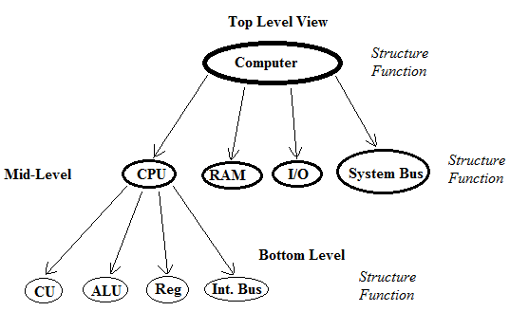
Hierarchical System: Block Diagram

Slide 25
Four basic ‘Functions’ of a Computer
Function is the operation of each individual component as part of the structure.
Four basic functions that a computer system can perform are:
1) Data processing 2) Data storage 3) Data movement 4) Control
The computer must be able to process data. The data may take a wide variety of forms and the range of processing requirements is broad. Process of items of data to produce meaningful information.
It is also essential that a computer must store data. Files of data are stored on the computer for subsequent retrieval and update.Fly processing

Slide 26
Four basic ‘Functions’
The computer must be able to move data between itself and the outside world and connects to devices that serve as either sources or destinations of data.
When data are received from or delivered to a device that is directly connected to the computer, the process is known as Input/Output (I/O), and the device is referred to as Peripheral. Data communication for remote devices.
Finally, there must be control of these three functions. This control is exercised by the individual(s) who provide the computer with instructions. A ‘control unit’ manages the computer’s resources in response to those instructions.

Slide 27
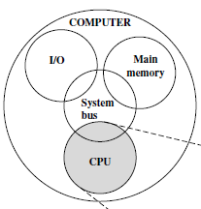
Internal Structure of the Computer
A computer has four main components: Their Functions are:
1) CPU 2) Main memory 3) I/O 4) System interconnections
Central Processing Unit (CPU) controls the operation of the computer and performs its data processing functions as ‘processor’.
Main memory stores program’s instructions and data at runtime.
I/O moves data between the computer and its external environment.
System interconnections provides for communication among CPU, main memory and I/O by means of a ‘system bus’.

Slide 28
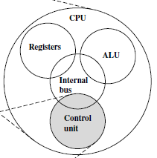
Structural Components of a Processor
CPU is the component that executes a program by performing arithmetic and logical operations on data.
The main structural components of a processor or a CPU are:
1) Control unit 2) ALU 3) Registers 4) CPU interconnections
Control unit controls the operation of the CPU and hence the computer. It controls ‘data processing’, ‘data movement’ and ‘data storage’.
Arithmetic and Logic Unit (ALU) performs the computer’s data processing functions.
Registers provide storage internal to the CPU.
CPU interconnections provide for communication among the control unit, ALU and registers by means of an ‘internal bus’.
It tells the computer's memory, ALU and I/O, how to respond to a program's instructions.
For ‘processed’ and ‘waiting’ data.

Slide 29
Control Unit
Within the CPU, a control unit manages the computers resources and manages the performance of its functional parts in response to those instructions.
The computer can function as a data storage device with data transferred from the external environment to computer storage (as Read) and vice versa (write).

Slide 30
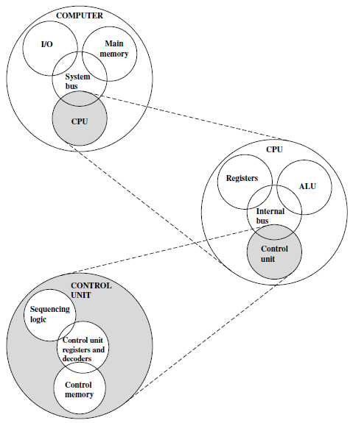
The Computer: Top-Level Structure

Slide 31
Multicore Computer Structure
Multicore processor is a semiconductor chip having multiple processor called cores embedded on it.
Each ‘Core’ is an individual processor having its own ALU and execution unit.
Each core executes its own set of instructions at the same time.
Having multiple cores in a system enhances its ‘performance’.
A multicore system supports ‘multitasking’ and ‘multi threading’.
Thread is an individual piece of code assigned to a single core.
Hyper-threading: A single core appears to the OS as two virtual cores.

Slide 32
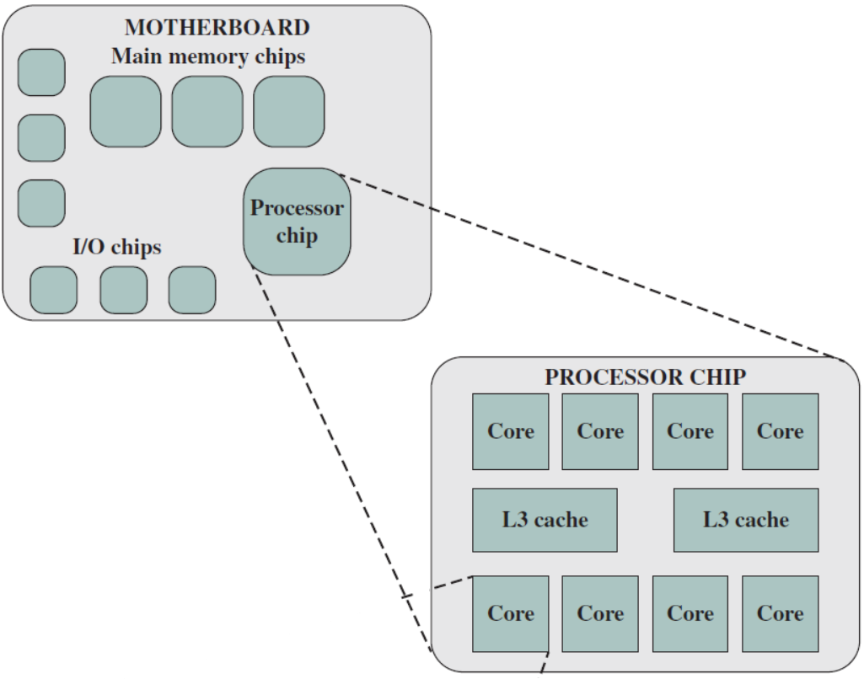
The motherboard is a rigid, flat board, that holds and interconnects chips and other electronic components.
The chip or IC (integrated circuits) is a single piece of semiconducting material, typically silicon (Si), upon which electronic circuits and logic gates are fabricated.

Slide 33
Components and Working of Control Unit (CU) Morris Page 231, Page 137
See book figure.
design of control unit in computer architecture (google)
https://www.studytonight.com/computer-architecture/design-of-control-unit.php
http://nptel.ac.in/courses/106103068/20
https://en.wikipedia.org/wiki/Control_unit
http://whatis.techtarget.com/definition/clock-speed
control signals in computer architecture (google)

Slide 34
design of arithmetic logic unit Morris Page 117 and page 164
http://www.explainthatstuff.com/howtransistorswork.html
How do transistors work in calculators and computers? ALU Logic
And or operations in weather and logic gates
The transistor is the primary building block of all microchips,
including your CPU, and is what creates the binary 0's and 1's (bits)
your computer uses to communicate and deal with Boolean logic.
When placed in different configurations, transistors form logic gates,
which can be combined into arrays called half adders that can also be
combined into full adders. [ALU]

